Slide 1
Fundamentals of Information Technology UNIT - II

Slide 2
Learning Objectives
In this Unit we will discuss :
Introduction to software:
Software types
Software Development activities
(Requirement, Design (algorithm, flowchart, decision table and tree), Coding, Testing, Installation, Maintenance).
Programming Languages
Assemblers
Compilers
interpreters
linkers

Slide 3
Learning Objectives
Introduction to Graphics primitives
Display Devices: Refresh Cathode Ray Tube, Raster Scan Display, Plasma Display, Liquid Crystal Display, Plotters, Printers,
Introduction to Input Devices
Keyboard, Trackball, Joystick, Mouse, Light Pen, Tablet and Digitizing Camera
External Storage devices.

Slide 4
Introduction to Software
Hardware refers to the physical devices of a computer system.
Software refers to a collection of programs
Program is a sequence of instructions written in a language that can be understood by a computer
Software package is a group of programs that solve a specific problem or perform a specific type of job

Slide 5
Introduction to Software
Both hardware and software are necessary for a computer to do useful job. They are complementary to each other.
Same hardware can be loaded with different software to make a computer system perform different types of jobs.
Except for upgrades, hardware is normally a one time expense, whereas software is a continuing expense.
Upgrades refer to renewing or changing components like increasing the main memory, or hard disk capacities, or adding speakers, modems, etc.

Slide 6
Introduction to Software
Types of Software
Most software can be divided into two major categories:
System software are designed to control the operation and extend the processing capability of a computer system
Application software are designed to solve a specific problem or to do a specific task

Slide 7
Introduction to Software
System Software
Make the operation of a computer system more effective and efficient
Help hardware components work together and provide support for the development and execution of application software
Programs included in a system software package are called system programs and programmers who prepare them are called system programmers
Examples of system software are operating systems, programming language translators, utility programs, and communications software

Slide 8
Introduction to Software
Application Software
Solve a specific problem or do a specific task
Programs included in an application software package are called application programs and the programmers who prepare them are called application programmers
Examples of application software are word processing, inventory management, preparation of tax returns, banking, etc.

Slide 9
Introduction to Software
Logical System Architecture

Slide 10
Introduction to Software
Software Life Cycle Models
The goal of Software Engineering is to provide models and processes that lead to the production of well-documented maintainable software in a manner that is predictable.

Slide 11
Introduction to Software
Software Life Cycle Models
“The period of time that starts when a software product is conceived and ends when the product is no longer available for use.
The software life cycle typically includes a requirement phase, design phase, implementation phase, test phase, installation and check out phase, operation and maintenance phase, and sometimes retirement phase”.

Slide 12
Introduction to Software
Build & Fix Model
Product is constructed without specifications or any attempt at design
Ad-hoc approach and not well defined
Simple two phase model

Slide 13
Introduction to Software
Build & Fix Model
Suitable for small programming exercises of 100 or 200 lines
Unsatisfactory for software for any reasonable size
Code soon becomes unfixable & unenhanceable
No room for structured design
Maintenance is practically not possible

Slide 14
Introduction to Software
Waterfall Model

Slide 15
Introduction to Software
Waterfall Model
This model is easy to understand and reinforces the notion of “define before design” and “design before code”.
The model expects complete & accurate requirements early in the process, which is unrealistic

Slide 16
Introduction to Software
Waterfall Model
Problems of waterfall model
i. It is difficult to define all requirements at the beginning of a
project
ii. This model is not suitable for accommodating any change
iii. A working version of the system is not seen until late in
the project’s life
iv. It does not scale up well to large projects.
v. Real projects are rarely sequential.

Slide 17
Introduction to Software
Incremental Process Models
They are effective in the situations where requirements are defined precisely and there is no confusion about the functionality of the final product.
After every cycle a useable product is given to the customer.
Popular particularly when we have to quickly deliver a limited functionality system.

Slide 18
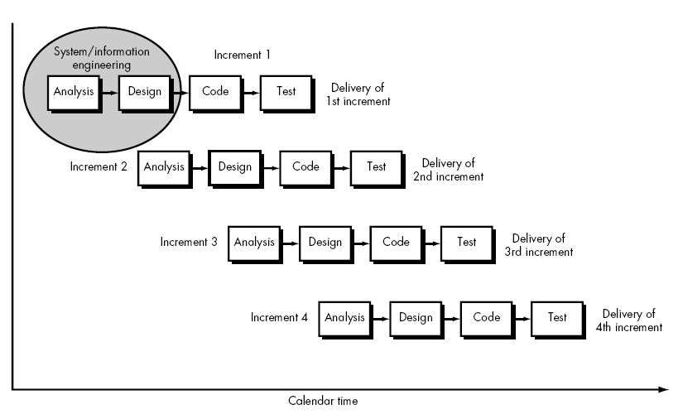
Incremental Process Models

Slide 19
Introduction to Software
Iterative Enhancement Model
This model has the same phases as the waterfall model, but with
fewer restrictions. Generally the phases occur in the same order as
in the waterfall model, but they may be conducted in several cycles.
Useable product is released at the end of the each cycle, with each
release providing additional functionality.
Customers and developers specify as many requirements as possible and prepare a SRS document.
Developers and customers then prioritize these requirements
Developers implement the specified requirements in one or more cycles of design, implementation and test based on the defined priorities.

Slide 20
Introduction to Software
Iterative Enhancement Model

Slide 21
Introduction to Software
Prototyping Model
The prototype may be a usable program but is not suitable as the final software product.
The code for the prototype is thrown away. However experience gathered helps in developing the actual system.
The development of a prototype might involve extra cost, but overall cost might turnout to be lower than that of an equivalent system developed using the waterfall model.

Slide 22
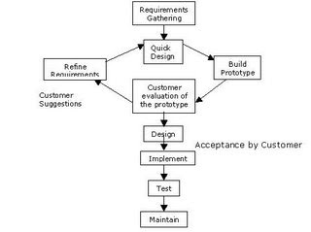
Introduction to Software

Slide 23
Introduction to Software
Software Development Steps
Developing a software and putting it to use is a complex process and involves following steps:
Analyzing the problem at hand and planning the program( s) to solve the problem
Coding the program (s)
Testing, debugging, and documenting the program (s)
Implementing the program (s)
Evaluating and maintaining the program (s)

Slide 24
SDLC
The Systems Development Life Cycle (SDLC), or Software Development Life Cycle in systems engineering, information systems and software engineering, is the process of creating or altering systems, and the models and methodologies that people use to develop these systems. The concept generally refers to computer or information systems.
In software engineering the SDLC concept underpins many kinds of software development methodologies. These methodologies form the framework for planning and controlling the creation of an information system: the software development process

Slide 25
SDLC
Requirements gathering and analysis
The goal of system analysis is to determine where the problem is .
This step involves "breaking down" the system in different pieces to analyze the situation, analyzing project goals, "breaking down" what needs to be created and attempting to engage users so that definite requirements can be defined. Requirements Gathering sometimes requires individuals/teams from client as well as service provider sides to get detailed and accurate requirements.
Often there has to be a lot of communication to and from to understand these requirements.

Slide 26
SDLC
Requirement gathering is the most crucial aspect as many times communication gaps arise in this phase and this leads to validation errors and bugs in the software program.
Requirements are gathered generally using IGT (Information Gathering Tools):
Questionnaire
Interviews
On Site observation

Slide 27
SDLC
Design
In systems, design functions and operations are described in detail, including screen layouts, business rules, process diagrams and other documentation.
The output of this stage will describe the new system as a collection of modules or subsystems.
The design stage takes as its initial input the requirements identified in the approved requirements document.
For each requirement, a set of one or more design elements will be produced as a result of interviews, workshops, and/or prototype efforts.

Slide 28
SDLC
Design elements describe the desired software features in detail, and generally include functional hierarchy diagrams, screen layout diagrams, tables of business rules, business process diagrams, pseudocode, and a complete entity-relationship diagram with a full data dictionary.
These design elements are intended to describe the software in sufficient detail that skilled programmers may develop the software with minimal additional input.

Slide 29
SDLC
ALGORITHM
An 'algorithm' is an effective method for solving a problem expressed as a finite sequence of instructions. Algorithms are used for calculation, data processing, and many other fields. (In more advanced or abstract settings, the instructions do not necessarily constitute a finite sequence, and even not necessarily a sequence; see, e.g., "nondeterministic algorithm".)

Slide 30
SDLC
Each algorithm is a list of well-defined instructions for completing a task. Starting from an initial state, the instructions describe a computation that proceeds through a well-defined series of successive states, eventually terminating in a final ending state. The transition from one state to the next is not necessarily deterministic; some algorithms, known as randomized algorithms, incorporate randomness.

Slide 31
Example: An algorithm to sum n natural numbers:
Input n
Initialize i=1, s=0
While i<=n
S=S + I
i=i + 1
Display s
End

Slide 32
SDLC
FLOWCHART
A flowchart is a type of diagram, that represents an algorithm or process, showing the steps as boxes of various kinds, and their order by connecting these with arrows. This diagrammatic representation can give a step-by-step solution to a given problem. Data is represented in these boxes, and arrows connecting them represent flow / direction of flow of data. Flowcharts are used in analyzing, designing, documenting or managing a process or program in various fields

Slide 33
SDLC
Symbols
A typical flowchart from older to computer science textbooks may have the following kinds of symbols:
Start and end symbols
Represented as circles, ovals or rounded rectangles, usually containing the word "Start" or "End", or another phrase signaling the start or end of a process, such as "submit enquiry" or "receive product".

Slide 34
SDLC
Arrows
Showing what's called "flow of control" in computer science. An arrow coming from one symbol and ending at another symbol represents that control passes to the symbol the arrow points to.
Processing steps
Represented as rectangles. Examples: "Add 1 to X"; "replace identified part"; "save changes" or similar.
Input/Output
Represented as a parallelogram. Examples: Get X from the user; display X.

Slide 35
SDLC
Conditional or decision
Represented as a diamond (rhombus). These typically contain a Yes/No question or True/False test. This symbol is unique in that it has two arrows coming out of it, usually from the bottom point and right point, one corresponding to Yes or True, and one corresponding to No or False. The arrows should always be labeled. A decision is necessary in a flowchart. More than two arrows can be used, but this is normally a clear indicator that a complex decision is being taken, in which case it may need to be broken-down further, or replaced with the "pre-defined process" symbol.

Slide 36
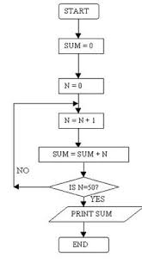
Flowchart to sum 50 integers

Slide 37
Decision Table
Each decision corresponds to a variable, relation or predicate whose possible values are listed among the condition alternatives.
Each action is a procedure or operation to perform, and the entries specify whether (or in what order) the action is to be performed for the set of condition alternatives the entry corresponds to.
Many decision tables include in their condition alternatives the don't care symbol, a hyphen.
Using don't cares can simplify decision tables, especially when a given condition has little influence on the actions to be performed. In some cases, entire conditions thought to be important initially are found to be irrelevant when none of the conditions influence which actions are performed.

Slide 38
Decision Table
A decision table is typically divided into four quadrants, as shown below.
The four quadrants
Conditions | Condition alternatives
Actions | Action entries

Slide 39
Decision Table - Example
The limited-entry decision table is the simplest to describe. The condition alternatives are simple boolean values, and the action entries are check-marks, representing which of the actions in a given column are to be performed.

Slide 40
Decision Table - Example
Example 1
No charges are reimbursed to the patient until the deductible has been met. After the deductible has been met, reimburse 50% for Doctor's Office visits or 80% for Hospital visits.
There will be 4 rules. The first condition (Is the deductible met?) has two possible outcomes, yes or no. The second condition (type of visit) has two possible outcomes, Doctor's office visit (D) or Hospital visit (H). Two times two is four.

Slide 41
Decision Table - Example
Example 1
Conditions | 1 | 2 | 3 | 4
1. Deductible met? | Y | Y | N | N
2. Type of visit | D | H | D | H
Actions
1. Reimburse 50% | X
2. Reimburse 80% |  | X
3. No reimbursement |  |  | X | X

Slide 42
Decision Table - Example
Example 2
No charges are reimbursed to the patient until the deductible has been met. Doctor's office visits are reimbursed at 50%, Hospital visits are reimbursed at 80% and Lab visits are reimbursed at 70%.
There will be 6 rules. The first condition (Is the deductible met?) has two possible outcomes, yes or no. The second condition (type of visit) has three possible outcomes, Doctor's office visit (D) or Hospital visit (H) or Lab visit (L). Two times three is 6.

Slide 43
Decision Table - Example
Conditions | 1 | 2 | 3 | 4 | 5 | 6
1. Deductible met? | Y | Y | Y | N | N | N
2. Type of visit | D | H | L | D | H | L
Actions
1. Reimburse 50% | X
2. Reimburse 80% |  | X
3. Reimburse 70% |  |  | X
4. No reimbursement |  |  |  | X | X | X

Slide 44
AIRFARE DISCOUNT
Infant passengers under two years old are offered a discount of 80% on domestic flights. Infant passengers under two years old are offered a discount of 70% on international flights. Youth passengers (between two and sixteen) are offered a discount of 10%, for any kind of destination. Passengers who make reservation five months before their journey are offered a discount of 10%. For international flights, passengers are offered 15% discount if they travel during off-seasons. There would be no discount for international flights, except that when the passenger is an infant passenger or when travelling during off-season. Frequent flyer enjoys a discount of 15%. The amount of discount is accumulated. The maximum amount of discount for infant passengers is 80% The maximum amount of discount for non-infant passengers is 20%.

Slide 45
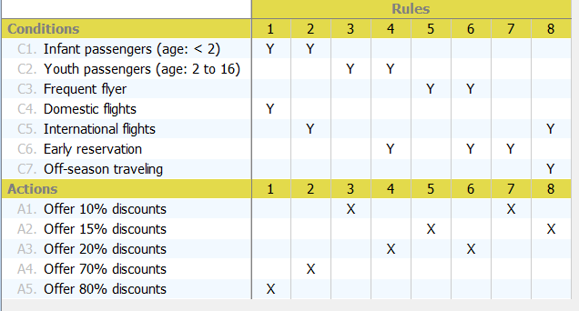

Slide 46
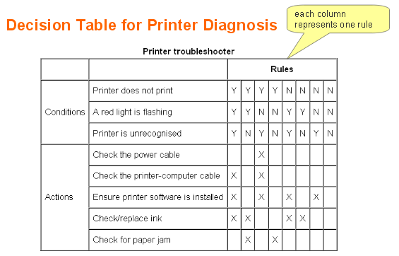
Decision Table - Example

Slide 47
SDLC
Decision Tree
A decision tree is a decision support tool that uses a tree-like graph or model of decisions and their possible consequences, including chance event outcomes, resource costs, and utility. Decision trees are commonly used in operations research, specifically in decision analysis, to help identify a strategy most likely to reach a goal. Another use of decision trees is as a descriptive means for calculating conditional probabilities. When the decisions or consequences are modeled by computational verb, then we call the decision tree a computational verb decision tree.

Slide 48
Decision Tree - Example
Imagine you only ever do four things at the weekend:
go shopping,
watch a movie,
play tennis or
just stay in.
What you do depends on three things: the weather (windy, rainy or sunny); how much money you have (rich or poor) and whether your parents are visiting. You say to your yourself: if my parents are visiting, we'll go to the cinema. If they're not visiting and it's sunny, then I'll play tennis, but if it's windy, and I'm rich, then I'll go shopping. If they're not visiting, it's windy and I'm poor, then I will go to the cinema. If they're not visiting and it's rainy, then I'll stay in.

Slide 49
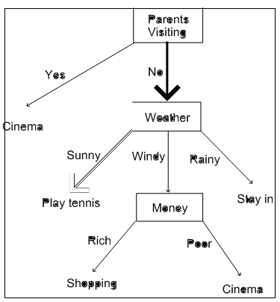
Decision Tree - Example

Slide 50
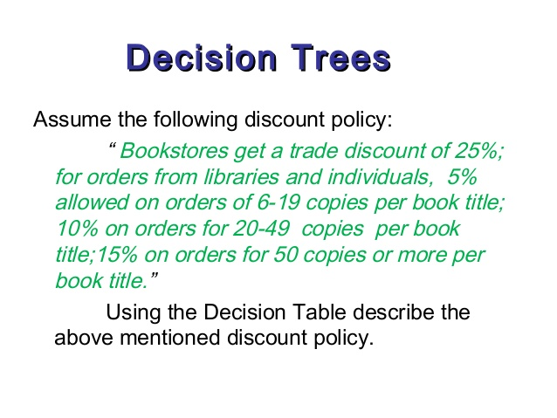

Slide 51
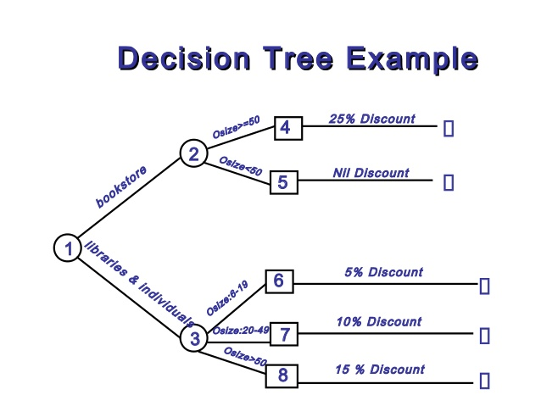

Slide 52
SDLC
Testing
The code is tested at various levels in software testing. Unit, system and user acceptance testing are often performed. This is a grey area as many different opinions exist as to what the stages of testing are and how much if any iteration occurs. Iteration is not generally part of the waterfall model, but usually some occur at this stage.
Below are the following types of testing:
Unit testing , System testing ,Integration testing, Black box testing, White box testing, Regression testing, User acceptance testing, Performance testing

Slide 53
Software Testing
What is Testing?
1. Testing is the process of demonstrating that errors are not present.
2. The purpose of testing is to show that a program performs its intended functions correctly.
3. Testing is the process of establishing confidence that a program does what it is supposed to do.
These definitions are inappropriate.

Slide 54
Software Testing
A more appropriate definition is:
“Testing is the process of executing a program with
the intent of finding errors.”

Slide 55
Software Testing Types
Black box testing – Internal system design is not considered in this type of testing. Tests are based on requirements and functionality.
White box testing – This testing is based on knowledge of the internal logic of an application’s code. Also known as Glass box Testing. Internal software and code working should be known for this type of testing. Tests are based on coverage of code statements, branches, paths, conditions.

Slide 56
Software Testing Types
Unit testing – Testing of individual software components or modules. Typically done by the programmer and not by testers, as it requires detailed knowledge of the internal program design and code. may require developing test driver modules or test harnesses.
Integration testing – Testing of integrated modules to verify combined functionality after integration. Modules are typically code modules, individual applications, client and server applications on a network, etc. This type of testing is especially relevant to client/server and distributed systems.

Slide 57
Software Testing Types
Load testing – Its a performance testing to check system behavior under load. Testing an application under heavy loads, such as testing of a web site under a range of loads to determine at what point the system’s response time degrades or fails.
Alpha testing – In house virtual user environment can be created for this type of testing. Testing is done at the end of development. Still minor design changes may be made as a result of such testing.
Beta testing – Testing typically done by end-users or others. Final testing before releasing application for commercial purpose.

Slide 58
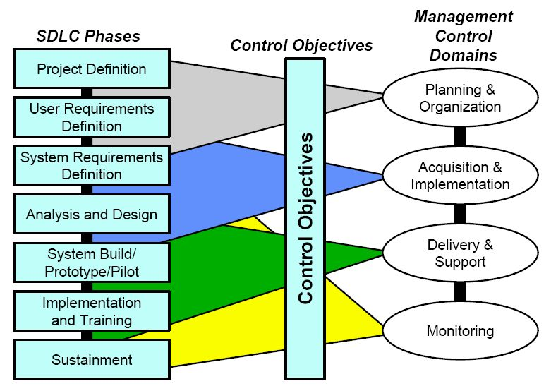
SDLC

Slide 59
Programming Languages
Classification of Computer Languages
Machine language
Assembly language
High-level language

Slide 60
Programming Languages
Machine Language
Only language of a computer understood by it without using a translation program
Normally written as strings of binary 1s and 0s
Written using decimal digits if the circuitry of the computer being used permits this

Slide 61
Programming Languages
Machine Language Instruction Format
OPCODE tells the computer which operation to perform from the instruction set of the computer
OPERAND tells the address of the data on which the operation is to be performed

Slide 62
Programming Languages
Machine Language
Advantage
Can be executed very fast
Limitations
Machine Dependent
Difficult to program
Error prone
Difficult to modify

Slide 63
Programming Languages
Assembly Language
Programming language that overcomes the limitations of machine language programming by:
1. Using alphanumeric mnemonic codes instead of numeric codes for the instructions in the instruction set
e.g. using ADD instead of 1110 (binary) or 14 (decimal) for instruction to add

Slide 64
Programming Languages
Assembly Language
2. Allowing storage locations to be represented in form of alpha numeric addresses instead of numeric addresses
e.g. representing memory locations 1000, 1001, and 1002 as FRST, SCND, and ANSR respectively
3. Providing pseudo-instructions that are used for instructing the system how we want the program to be assembled inside the computer’s memory
e.g. START PROGRAM AT 0000; SET ASIDE AN ADRESS FOR FRST

Slide 65
Programming Languages
Assembler
Software that translates as assembly language program into an equivalent machine language program of a computer

Slide 66
Programming Languages
Assembly Language
Advantages:
Easier to understand and use
Easier to locate and correct errors
Easier to modify
No worry about addresses
Easily relocatable
Efficiency of machine language

Slide 67
Programming Languages
Assembly Language
Disadvantages:
Machine dependent
Knowledge of hardware required
Machine level coding

Slide 68
Programming Languages
High Level Language
Machine independent
Do not require programmers to know anything about the internal structure of computer on which high-level language programs will be executed
Deal with high-level coding, enabling the programmers to write instructions using English words and familiar mathematical symbols and expressions

Slide 69
Programming Languages
Compiler
Translator program (software) that translates a high level language program into its equivalent machine language program
Compiles a set of machine language instructions for every program instruction in a high-level language

Slide 70
Programming Languages
Compiler

Slide 71
Programming Languages
Compiler
In addition to doing translation job, compilers also automatically detect and indicate syntax errors. Syntax errors are typically of following types:
Illegal characters
Illegal combination of characters
Improper sequencing of instructions in a program
Use of undefined variable names

Slide 72
Programming Languages
Linker
For a large software, storing all the lines of program
code in a single source file will be:
– Difficult to work with
– Difficult to deploy multiple programmers to concurrently work towards its development
– Any change in the source program would require the entire source program to be recompiled
Hence, a modular approach is generally adapted to develop large software where the software consists of multiple source program files

Slide 73
Programming Languages
Linker
No need to write programs for some modules as it might be available in library offering the same functionality
Each source program file can be independently modified and compiled to create a corresponding object program file
Linker program (software) is used to properly combine all the object program files (modules)
Creates the final executable program (load module)

Slide 74
Programming Languages
Interpreter
Interpreter is a high-level language translator
Takes one statement of a high-level language program, translates it into machine language instructions
Immediately executes the resulting machine language instructions
Compiler simply translates the entire source program into an object program and is not involved in its execution

Slide 75
Programming Languages
Interpreter

Slide 76
Programming Languages
Interpreter
New type of compiler and interpreter combines the speed, ease, and control of both compiler and interpreter
Compiler first compiles the source program to an intermediate object program
Intermediate object program is not a machine language code but written in an intermediate language that is virtually machine independent
Interpreter takes intermediate object program, converts it into machine language program and executes it

Slide 77
Programming Languages
High Level Language
Advantages
Machine independent
Easier to learn and use
Fewer errors during program development
Lower program preparation cost
Better documentation
Easier to maintain

Slide 78
Programming Languages
High Level Language
Disadvantages
Lower execution efficiency
Less flexibility to control the computer’s CPU, memory and registers

Slide 79
Introduction of Input Devices
Provide means of communication between a computer and outer world
Also known as peripheral devices because they surround the CPU and memory of a computer system
Input devices are used to enter data from the outside world into primary storage
Output devices supply results of processing from primary storage to users

Slide 80
Introduction of Input Devices
Role of Input Devices

Slide 81
Introduction of Input Devices
Input Devices
Keyboard devices
Point-and-draw devices
Data scanning devices
Digitizer
Electronic cards based devices
Speech recognition devices
Vision based devices

Slide 82
Introduction of Input Devices
Keyboard Devices
Allow data entry into a computer system by pressing a set of keys (labeled buttons) neatly mounted on a keyboard connected to a computer system
101-keys QWERTY keyboard is most popular

Slide 83
Introduction of Input Devices
Keyboard Devices

Slide 84
Introduction of Input Devices
Point--and--Draw Devices
Used to rapidly point to and select a graphic icon or menu item from multiple options displayed on the Graphical User Interface (GUI) of a screen
Used to create graphic elements on the screen such as lines, curves, and freehand shapes
Some commonly used point-and-draw devices are mouse, track ball, joy stick, light pen, and touch screen

Slide 85
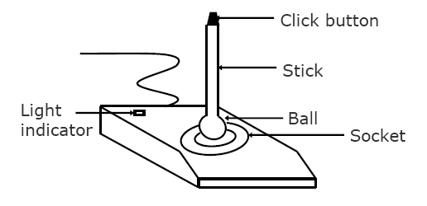
Introduction of Input Devices
Joystick

Slide 86
Introduction of Input Devices
Electronic Pen
Pen-based point-and-draw device
Used to directly point with it on the screen to select menu items or icons or directly draw graphics on the screen
Can write with it on a special pad for direct input of written information to a system
Pressure on tip of a side button is used to cause same
action as right-button-click of a mouse

Slide 87
Introduction of Input Devices
Touch Screen
Most simple, intuitive, and easiest to learn of all input devices
Enables users to choose from available options by simply touching with their finger the desired icon or menu item displayed on the screen
Most preferred human-computer interface used in information kiosks (unattended interactive information systems such as automatic teller machine or ATM)

Slide 88
Introduction of Input Devices
Data Scanning Devices
Input devices that enable direct data entry into a computer system from source documents
Eliminate the need to key in text data into the computer
Due to reduced human effort in data entry, they improve data accuracy and also increase the timeliness of the information processed
Demand high quality of input documents
Some data scanning devices are also capable of recognizing marks or characters
Form design and ink specification usually becomes more
critical for accuracy

Slide 89
Introduction of Input Devices
Image Scanner
Input device that translates paper documents into an electronic format for storage in a computer
Electronic format of a scanned image is its bit map representation
Stored image can be altered or manipulated with an image-processing software

Slide 90
Introduction of Input Devices
Electronic Card Reader
Electronic cards are small plastic cards having encoded data appropriate for the application for which they are used
Electronic-card reader (normally connected to a computer) is used to read data encoded on an electronic card and transfer it to the computer for further processing
Used together as a means of direct data entry into a computer system
Used by banks for use in automatic teller machines (ATMs) and by organizations for controlling access of employees to physically secured areas

Slide 91
Introduction of Input Devices
Digitizer
Input device used for converting (digitizing) pictures, maps and drawings into digital form for storage in computers
Commonly used in the area of Computer Aided Design (CAD) by architects and engineers to design cars, buildings medical devices, robots, mechanical parts, etc.
Used in the area of Geographical Information System (GIS) for digitizing maps available in paper form

Slide 92
Introduction of Input Devices
Digitizer

Slide 93
Introduction to Output Devices
Commonly Used Output Devices
Monitors
Printers
Plotters
Screen image projector
Voice response systems

Slide 94
Introduction to Output Devices
Types of Output
Soft-copy output
Not produced on a paper or some material that can be touched and carried for being shown to others
Temporary in nature and vanish after use
Examples are output displayed on a terminal screen or spoken out by a voice response system
Hard-copy output
Produced on a paper or some material that can be touched and carried for being shown to others
Permanent in nature and can be kept in paper files or can be looked at a later time when the person is not using the computer
Examples are output produced by printers or plotters on paper

Slide 95
Introduction to Output Devices
Monitors
Monitors are the most popular output devices used for producing soft-copy output
Display the output on a television like screen
Monitor associated with a keyboard is called a video display terminal (VDT). It is the most popular I/O device

Slide 96
Introduction to Output Devices

Slide 97
Introduction to Output Devices
Types of Monitors
Cathode-ray-tube (CRT) monitors look like a television
and are normally used with non-portable computer systems
Flat-panel monitors are thinner and lighter and are commonly used with portable computer systems like notebook computers. Now they are also used with non portable desktop computer systems because they occupy less table space.

Slide 98
Introduction to Output Devices
Refresh Cathode Ray Tube
The Cathode Ray Tube (CRT) is a vacuum tube containing an electron gun (a source of electrons) and a fluorescent screen, with internal or external means to accelerate and deflect the electron beam, used to create images in the form of light emitted from the fluorescent screen. The image may represent electrical waveforms (oscilloscope), pictures (television, computer monitor), radar targets and others.
The CRT uses an evacuated glass envelope which is large, deep, heavy, and relatively fragile.

Slide 99
Introduction to Output Devices
Raster Scan Display
A raster scan, or raster scanning, is the rectangular pattern of image capture and reconstruction in television.
It's a systematic process of covering the area progressively, one line at a time. Although often a great deal faster, it's similar in the most-general sense to how one's gaze travels when one reads text.
In a raster scan, an image is subdivided into a sequence of (usually horizontal) strips known as "scan lines".
Each scan line can be transmitted in the form of an analog signal as it is read from the video source, as in television systems, or can be further divided into discrete pixels for processing in a computer system.
This ordering of pixels by rows is known as raster order, or raster scan order.

Slide 100
Introduction to Output Devices
Plasma Display
A plasma display panel (PDP) is a type of flat panel display common to large TV displays (80 cm or larger).
They are called "plasma" displays because the pixels rely on plasma cells, or what are in essence chambers more commonly known as fluorescent lamps.
A panel typically has millions of tiny cells in compartmentalized space between two panels of glass.
These compartments, or "bulbs" or "cells", hold a mixture of noble gases and a very small amount of mercury.

Slide 101
Introduction to Output Devices
Liquid Crystal Display
A liquid crystal display (LCD) is a thin, flat electronic visual display that uses the light modulating properties of liquid crystals (LCs). LCs do not emit light directly.
They are used in a wide range of applications including: computer monitors, television, instrument panels, aircraft cockpit displays, signage, etc.
They are common in consumer devices such as video players, gaming devices, clocks, watches, calculators, and telephones. LCDs have displaced cathode ray tube (CRT) displays in most applications.

Slide 102
Introduction to Output Devices
They are usually more compact, lightweight, portable, less expensive, more reliable, and easier on the eyes.
They are available in a wider range of screen sizes than CRT and plasma displays, and since they do not use phosphors, they cannot suffer image burn-in.
LCDs are more energy efficient and offer safer disposal than CRTs. Its low electrical power consumption enables it to be used in battery-powered electronic equipment.
It is an electronically-modulated optical device made up of any number of pixels filled with liquid crystals and arrayed in front of a light source (backlight)or reflector to produce images in colour or monochrome.

Slide 103
Introduction to Output Devices
Printers
Most common output devices for producing hard-copy
output

Slide 104
Introduction to Output Devices
Dot-Matrix Printers
Character printers that form characters and all kinds of images as a pattern of dots
Print many special characters, different sizes of print and graphics such as charts and graphs
Impact printers can be used for generating multiple copies by using carbon paper or its equivalent
Slow, with speeds usually ranging between 30 to 600 characters per second Cheap in both initial cost and cost of operation

Slide 105
Introduction to Output Devices
Dot-Matrix Printers

Slide 106
Introduction to Output Devices
Inkjet Printers
Character printers that form characters and all kinds of images by spraying small drops of ink on to the paper
Print head contains up to 64 tiny nozzles that can be selectively heated up in a few micro seconds by an integrated circuit register
To print a character, the printer selectively heats the appropriate set of nozzles as the print head moves horizontally
Can print many special characters, different sizes of print,
and graphics such as charts and graphs

Slide 107
Introduction to Output Devices
Inkjet Printers

Slide 108
Introduction to Output Devices
Drum Printers
Line printers that print one line at a time
Have a solid cylindrical drum with characters embossed
on its surface in the form of circular bands
Set of hammers mounted in front of the drum in such a
manner that an inked ribbon and paper can be placed between the hammers and the drum
Can only print a pre-defined set of characters in a predefined style that is embossed on the drum
Impact printers and usually monochrome
Typical speeds are in the range of 300 to 2000 lines per
minute

Slide 109
Introduction to Output Devices
Drum Printers

Slide 110
Introduction to Output Devices
Laser Printers
Page printers that print one page at a time
Consist of a laser beam source, a multi-sided mirror, a photoconductive drum and toner (tiny particles of oppositely charged ink)
To print a page, the laser beam is focused on the electro statically charged drum by the spinning multi-sided mirror
Toner sticks to the drum in the places the laser beam has
charged the drum’s surface.
Toner is then permanently fused on the paper with heat and pressure to generate the printer output
Laser printers produce very high quality output having
resolutions in the range of 600 to 1200 dpi

Slide 111
Introduction to Output Devices
Laser Printers

Slide 112
Introduction to Output Devices
Plotters
Plotters are an ideal output device for architects, engineers, city planners, and others who need to routinely generate high-precision, hard-copy graphic output of widely varying sizes
Two commonly used types of plotters are:
Drum plotter, in which the paper on which the design has to be made is placed over a drum that can rotate in both clockwise and anti-clockwise directions
Flatbed plotter, in which the paper on which the design has to be made is spread and fixed over a rectangular flatbed table

Slide 113
Introduction to Output Devices
Plotters

Slide 114
Introduction to Storage Devices
Storage devices hold data, even when the computer is turned off.
The physical material that actually holds data is called a storage medium. The surface of a floppy disk is a storage medium.
The hardware that writes data to or reads data from a storage medium is called a storage device. A floppy disk drive is a storage device.
The two primary storage technologies are magnetic and optical.

Slide 115
Introduction to Storage Devices
The primary types of magnetic storage are:
Diskettes (floppy disks)
Hard disks
High-capacity floppy disks
Disk cartridges
Magnetic tape

Slide 116
Introduction to Storage Devices
The primary types of optical storage are:
Compact Disk Read-Only Memory (CD-ROM)
Digital Video Disk Read-Only Memory (DVD-ROM)
CD-Recordable (CD-R)
CD-Rewritable (CD-RW)
Photo CD

Slide 117
Introduction to Storage Devices
Magnetic Storage Devices - How Magnetic Storage Works
A magnetic disk's medium contains iron particles, which can be polarized—given a magnetic charge—in one of two directions.
Each particle's direction represents a 1 (on) or 0 (off), representing each bit of data that the CPU can recognize.
A disk drive uses read/write heads containing electromagnets to create magnetic charges on the medium.

Slide 118
Introduction to Storage Devices
Magnetic Storage Devices - Formatting
Before a magnetic disk can be used, it must be formatted—a process that maps the disk's surface and determines how data will be stored.
During formatting, the drive creates circular tracks around the disk's surface, then divides each track into sectors.
The OS organizes sectors into groups, called clusters, then tracks each file's location according to the clusters it occupies.

Slide 119
Introduction to Storage Devices
Magnetic Storage Devices - Disk Areas
When a disk is formatted, the OS creates four areas on its surface:
Boot sector – stores the master boot record, a small program that runs when you first start (boot) the computer
File allocation table (FAT) – a log that records each file's location and each sector's status
Root folder – enables the user to store data on the disk in a logical way
Data area – the portion of the disk that actually holds data

Slide 120
Introduction to Storage Devices
Magnetic Storage Devices - Diskettes
Diskette drives, also known as floppy disk drives, read and write to diskettes (called floppy disks or floppies).
Diskettes are used to transfer files between computers, as a means for distributing software, and as a backup medium.
Diskettes come in two sizes: 5.25-inch and 3.5-inch.

Slide 121
Introduction to Storage Devices
Magnetic Storage Devices - Diskettes
Diskette drives, also known as floppy disk drives, read and write to diskettes (called floppy disks or floppies).
Diskettes are used to transfer files between computers, as a means for distributing software, and as a backup medium.
Diskettes come in two sizes: 5.25-inch and 3.5-inch.

Slide 122
Introduction to Storage Devices
Magnetic Storage Devices - Hard Disks
Hard disks use multiple platters, stacked on a spindle. Each platter has two read/write heads, one for each side.
Hard disks use higher-quality media and a faster rotational speed than diskettes.
Removable hard disks combine high capacity with the convenience of diskettes.

Slide 123
Introduction to Storage Devices
Magnetic Storage Devices - Disk Capacities
Diskettes are available in different capacities, but the most common store 1.44 MB.
Hard disks store large amounts of data. New PCs feature hard disks with capacities of 500 GB and higher.

Slide 124
Introduction to Storage Devices
Magnetic Storage Devices - Other Magnetic Storage Devices
High-capacity floppy disks offer capacities up to 250MB and the portability of standard floppy disks.
Disk cartridges are like small removable hard disks, and can store up to 2 GB.
Magnetic tape systems offer very slow data access, but provide large capacities and low cost.

Slide 125
Introduction to Storage Devices
Optical Storage Devices
How Optical Storage Works
CD-ROM
CD-ROM Speeds and Uses
DVD-ROM
Other Optical Storage Devices

Slide 126
Introduction to Storage Devices
Optical Storage Devices – How Optical Storage Works
An optical disk is a high-capacity storage medium. An optical drive uses reflected light to read data.
To store data, the disk's metal surface is covered with tiny dents (pits) and flat spots (lands), which cause light to be reflected differently.
When an optical drive shines light into a pit, the light cannot be reflected back. This represents a bit value of 0 (off). A land reflects light back to its source, representing a bit value of 1 (on).

Slide 127
Introduction to Storage Devices
Optical Storage Devices – CD-ROM
In PCs, the most commonly used optical storage technology is called Compact Disk Read-Only Memory (CD-ROM).
A standard CD-ROM disk can store up to 650 MB of data, or about 70 minutes of audio.
Once data is written to a standard CD-ROM disk, the data cannot be altered or overwritten.

Slide 128
Introduction to Storage Devices
Optical Storage Devices – CD-ROM Speeds and Uses
Early CD-ROM drives were called single speed, and read data at a rate of 150 KBps. (Hard disks transfer data at rates of 5 – 15 MBps).
CD-ROM drives now can transfer data at speeds of up to 7800 KBps. Data transfer speeds are getting faster.
CD-ROM is typically used to store software programs. CDs can store audio and video data, as well as text and program instructions.

Slide 129
Introduction to Storage Devices
Optical Storage Devices - DVD-ROM
A variation of CD-ROM is called Digital Video Disk Read-Only Memory (DVD-ROM), and is being used in place of CD-ROM in many newer PCs.
Standard DVD disks store up to 9.4 GB of data—enough to store an entire movie. Dual-layer DVD disks can store up to 17 GB.
DVD disks can store so much data because both sides of the disk are used, along with sophisticated data compression technologies.

Slide 130
Conclusion
Introduction to software:
Software types
Software Development activities
(Requirement, Design (algorithm, flowchart, decision table and tree), Coding, Testing, Installation, Maintenance).
Programming Languages
Assemblers
Compilers
interpreters
linkers
Introduction to Graphics primitives
Display Devices: Refresh Cathode Ray Tube, Raster Scan Display, Plasma Display, Liquid Crystal Display, Plotters, Printers,
Introduction to Input Devices
Keyboard, Trackball, Joystick, Mouse, Light Pen, Tablet and Digitizing Camera
External Storage devices.

Slide 131
Objective Type
Antivirus is Application Software (T/F).
Compiler is used to translate code from Assembly language to Low Level. (T/F)
Printer is soft copy device. (T/F)
Tablet is output device. (T/F)
RAM is secondary memory. (T/F)
Arrange SDLC Phases :
Requirement b) Coding
Testing d) Implementation
7. OMR is input device. (T/F)
8. What is pseudocode ?
9. Assembler is used to translate code from High Level language to Low Level language. (T/F)
10. FDISK is utility software.

Slide 132
Short Questions
What is a flowchart? Draw a flowchart that generates a Fibonacci series (1, 1, 2, 3, 5, ….N terms).
Differentiate low level and high level language with examples.
Difference between compiler and interpreter.
Write a short note on Application Software.
What are the display devices. Explain two devices.
Write a short note on Refresh Cathode Ray Tube.
Explain Raster Scan display.
What are the different types of testing in SDLC.
Difference between Decision Tree and Decision Table.
Difference between optical disk and magnetic disk.

Slide 133
Long Questions
Explain SDLC.
What are the input devices? Explain four input devices.
What are the output devices? Difference between soft-output and hard-output.
What is the difference between primary and secondary storage devices
Describe various types of secondary storage devices.
Explain different types of programming languages.
Explain different types of software.
What are the different types of printers. Explain.
Write a short note on LCD.
Write a short note on Plotters.

Slide 134
References
Main Reading Books:
1. P. K. Sinha and Priti Sinha , “Computer Fundamentals”, BPB Publications, 2007.
2. Alex Leon and Mathews Leon, “Fundamentals of Information Technology”, Leon Techworld, 2007.
3. V. Rajaraman, “Introduction to Information Technology”, PHI, 2006.
REFERENCES:
1. Alex Leon and Mathews Leon, “Introduction to Computers”, Vikas Publishing House,2007.
2. Norton Peter, “Introduction to computers”, TMH, 4th Ed., 2006.
3. Simon Haykins, “Communication System”, John Wiley & Sons, 2006.
4. B. Basaraj, “Digital Fundamentals”, Vikas Publications, 1999.
5. 6. V. Rajaraman, “Fundamentals of Computers”, PHI, 5th Ed., 2006.
7. David Anfinson and Ken Quamme, “IT Essentials PC Hardware and Software Component on Guide”, Pearson, 3rd Ed., 2008.
8. Malvino and Leach, “Digital Principles and Application”, TMH, 1999.
9. Ramesh S. Gaonkar, "Microprocessor Architecture Programming and Application with 8085”, PHI, 2001.

